Slide 1

Design and Implementation of a Keyword-Based Retrieval Search Engine
Group 13
Abhishek Vijaykumar Mane
Andrew Graham Porter
Mohammad Asghar
Shreya Murigendra Pattanashetti

Slide 2
Overview
Aim, Task and Dataset
General Architecture of the model
Data Preprocessing of Vector Space Model (VSM)
Topic Clustering
Spherical K-Means: Core Mechanics
Understanding The Search Function
Evaluation Metric for K-means Clustering
Comparison between the Retrieval Models
References

Slide 3
Aim, Task and Dataset:
Aim
Objective: Develop a sophisticated search engine.
Focus: Index Wikipedia articles for precise, efficient information retrieval.
Outcome: Enhance text analysis and retrieval, improving scalability across extensive textual content.
Task
Objective: Create a streamlined indexing framework within 'wiki-articles.json'. Foundational Vector Space Model (VSM) enhanced with K-Means clustering
Functionality: Enable efficient keyword-based searches by cataloging word occurrences.
Benefit: Ensure relevance by effectively identifying articles matching user queries.
Dataset
Content: Wikipedia articles (ID, URL, title, body text)
Value: Leverages Wikipedia's diverse, in-depth information for robust search engine testing across various topics.
(Zubiaga, 2023)

Slide 4
General Architecture of the model
Preprocessing
(Tokenization,
Stop Words,
Lemmatization,
Stemming)
Document Loading
Vectorization (TF-IDF)
Clustering
(K-Means)
Dimensionality Reduction (SVD)
Query Processing (Vectorization, Reduction, Relevant Cluster Retrieval)
Index creation
Optimal Clusters Determination with Silhouette Score
Results
Figure 1: Keyword-Based Search Engine Architecture incorporating Vector Space Model

Slide 5
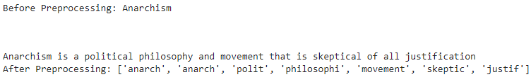
Data Preprocessing of Vector Space Model (VSM)
Steps in Data Processing
Tokenization: Break text into words or tokens, making raw text analyzable (e.g., "Text data" → ["Text", "data"]). (Cambridge University Press, 2008)
Stop Words Removal: Eliminate common words with minimal semantic value to focus on meaningful content (e.g., remove "is", "and").
Lemmatization: Convert words to their base form, harmonizing variations (e.g., "Running" → "Run").
Stemming: Trim words to their root form, often faster but less precise than lemmatization (e.g., "Preprocessing" → "Preprocess"). (Otten, 2023)
TF-IDF Vectorization: Transform text to vectors, highlighting term significance within and across documents. (Zhang, 2024)
Dimensionality Reduction (SVD): Simplify features to the most significant ones for analysis, reducing data complexity ('[0.5, 0.5, 0.7, 0.4, …]' → '[0.5, 0.5]'). (Dimensionality Reduction, n.d., pp.418–423)
Figure. First 100 characters of a random article from wiki-articles file before & after preprocessing

Slide 6

Topic Clustering
(
Spherical Clustering (Salton & Yang, 1975; Zhong, 2005; Hornik, 2012)
Indexing
Within Cluster Search:
Efficiency Boost
Scalability Improvements
Why K-Means?
"Partitional clustering algorithms have been recognized to be better suited for handling large document datasets than hierarchical ones, due to their relatively low computational requirements [16, 9, 3]." (Huang, 2008, p.52)

Slide 7
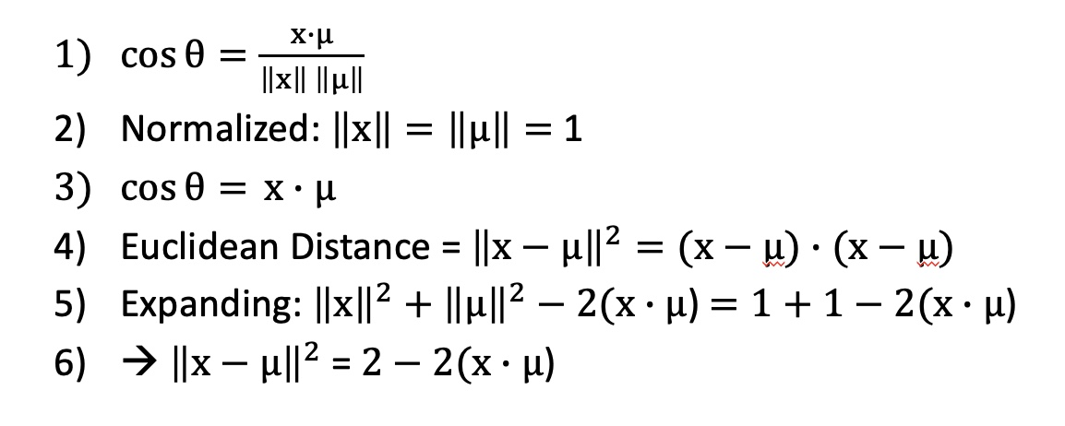
Spherical K-Means: Core Mechanics
A shift from Euclidean Distance to Cosine Similarity...
Notation (adapted from Zhong, 2005):

Slide 8
Understanding The Search Function
Query Vectorization
Dimensionality Reduction of Query Vector
Compute Similarities to Cluster Centroids
Identify Most Relevant Cluster
Compute Similarities to Documents in the Cluster
Identifies and Retrieves Most Similar Documents

Slide 9
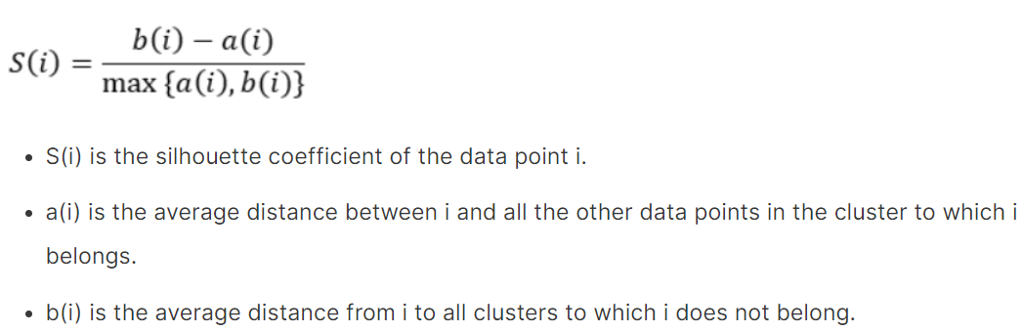
Evaluation Metric for K-means Clustering
Why Silhouette Coefficient?
Objective Measure: Quantifies cluster quality without external labels.
Range and Interpretability: Values from -1 to 1, where 1 signifies perfect clustering, 0 overlapping clusters, and -1 indicates poor clustering.
Decision Support: Helps choose the optimal number of clusters by providing a quantitative measure to compare across different k values. (Banerji, 2021)
Why Effective for Vector Space Model with KMeans?
Optimization of K: Guides in selecting the number of clusters for best results.
Balance between Cohesion and Separation: Ensures clusters are both tight and distinct.
Figure. Silhouette Coefficient Formula (Banerji, 2021)

Slide 10
Comparison between the Retrieval Models
Efficiency of VSM Model: Overall runtime of model was 999.641 seconds ≈ 16.66 mins.
Efficiency of BM25 Model: Overall runtime of model was 1374.389 seconds ≈ 22.91 mins.
Query | Vector Space Model (VSM) | BM25 Model | Vector Space Model (VSM) | BM25 Model
 | Time Lag (Efficiency) | Time Lag (Efficiency) | Model Effectiveness | Model Effectiveness
"Python Programming" | 0.0943 seconds | 0.0590 seconds | 4/5 (80%) | 3/5 (60%)
"World War" | 0.0540 seconds | 0.0330 seconds | 4/5 (80%) | 3/5 (60%)
"Planet" | 0.0980 seconds | 0.0600 seconds | 5/5 (100%) | 5/5 (100%)

Slide 11
Comparison between the Retrieval Models
Query = "Python Programming" | Vector Space Model (VSM) Relevance | BM25 Model Relevance
Article 1 | 'Program' | Python (programming language)
Article 2 | 'Polymorphism in object-oriented programming' | Spam (Monty Python sketch)
Article 3 | 'Procedural programming | Zope
Article 4 | &quot;Hello, World!quot:program | Ruby (programming language)
Article 5 | Literate programming | Monty Python
Mean Average Precision (mAP) | 0.8764 | 0.8556

Slide 12
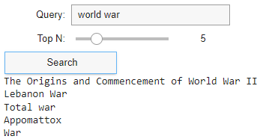
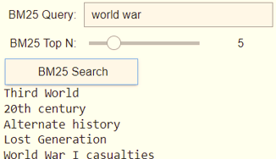
Comparison between the Retrieval Models
VSM BM25
VSM
BM25

Slide 13
References
Cambridge University Press (2008) Tokenization. Available at: https://nlp.stanford.edu/IR book/html/htmledition/tokenization-1.html (Accessed: 07 March 2024).
Hornik, K., Feinerer, I., Kober, M. and Buchta, C., 2012. Spherical k-means clustering. Journal of statistical software, 50, pp.1-22.
Huang, A., 2008, April. Similarity measures for text document clustering. In Proceedings of the sixth new zealand computer science research student conference (NZCSRSC2008), Christchurch, New Zealand (Vol. 4, pp. 9-56).
Otten, N.V. (2023) How to use text normalization techniques in NLP with python [9 ways], Spot Intelligence. Available at: https://spotintelligence.com/2023/01/25/text-normalization-techniques nlp/#3_Stop_Word_Removal (Accessed: 07 March 2024).
Salton, G., Wong, A. and Yang, C.S., 1975. A vector space model for automatic indexing. Communications of the ACM, 18(11), pp.613-620.
Zhang, Q., 2024. Indexing and TF-IDF. [Lecture] Information Retrieval, Week 2, Queen Mary University of London
Zhong, S., 2005, July. Efficient online spherical k-means clustering. In Proceedings. 2005 IEEE International Joint Conference on Neural Networks, 2005. (Vol. 5, pp. 3180-3185). IEEE.
Dimensionality Reduction. (n.d.). [online] Stanford University, pp.418–423. Available at: http://infolab.stanford.edu/~ullman/mmds/ch11.pdf [Accessed 10 Apr. 2024].
Banerji, A. (2021). K-Mean | K Means Clustering | Methods To Find The Best Value Of K. [online] Analytics Vidhya. Available at: https://www.analyticsvidhya.com/blog/2021/05/k-mean-getting-the-optimal-number-of-clusters/.

